Slide 1



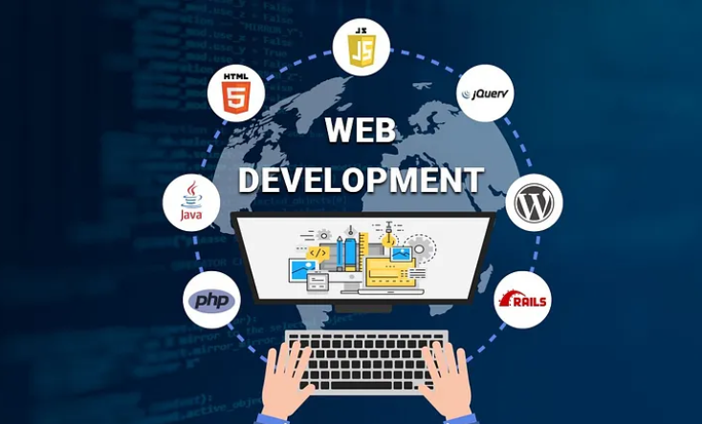
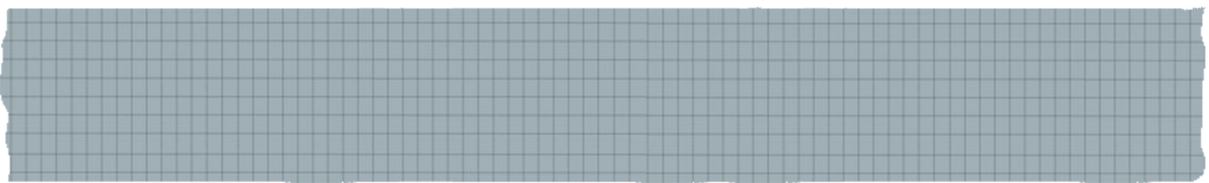

WEB DEVELOPMENT
PROJECT OVERVIEW

Slide 2
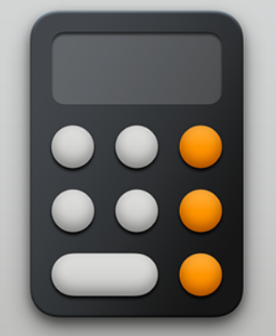
PROJECT NAME
Calculator Application

Slide 3


Description
This web application is a calculator that allows users to perform basic arithmetic operations (addition, subtraction, multiplication, division) on numbers. It provides a user-friendly interface for entering digits and performing calculations.

Slide 4

Technologies Used
Frontend Framework: React
Styling: CSS (with some external styling libraries)
Version Control: Git (with GitHub for repository hosting)
Package Management: npm (Node Package Manager)
Code Editor: Visual Studio Code

Slide 5
5
State Management: - State is managed using the `useReducer` hook, ensuring predictable and controlled updates.
1
3
.Basic Arithmetic Operations: - Addition, subtraction, multiplication, and division operations are supported.
Decimal Point Handling: - The application ensures that only one decimal point can be entered in a number.
Features
2
4
Clear and Delete Functionality: - Users can clear the display or delete the last entered digi
Error Handling: - The application is designed to handle edge cases and prevent invalid input.

Slide 6

Code Structure
Component-Based Architecture: The application is built using a component-based architecture. Each component handles a specific aspect of the UI (e.g., buttons, display).
Reducer for State Management: State is managed using a reducer function, which processes actions and returns a new state based on the action type.
Spread Operator for Immutability: The spread operator (`...`) is used to create new state objects, ensuring immutability and predictable state updates.

Slide 7
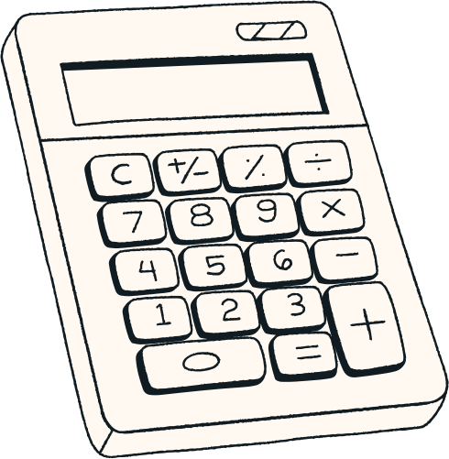

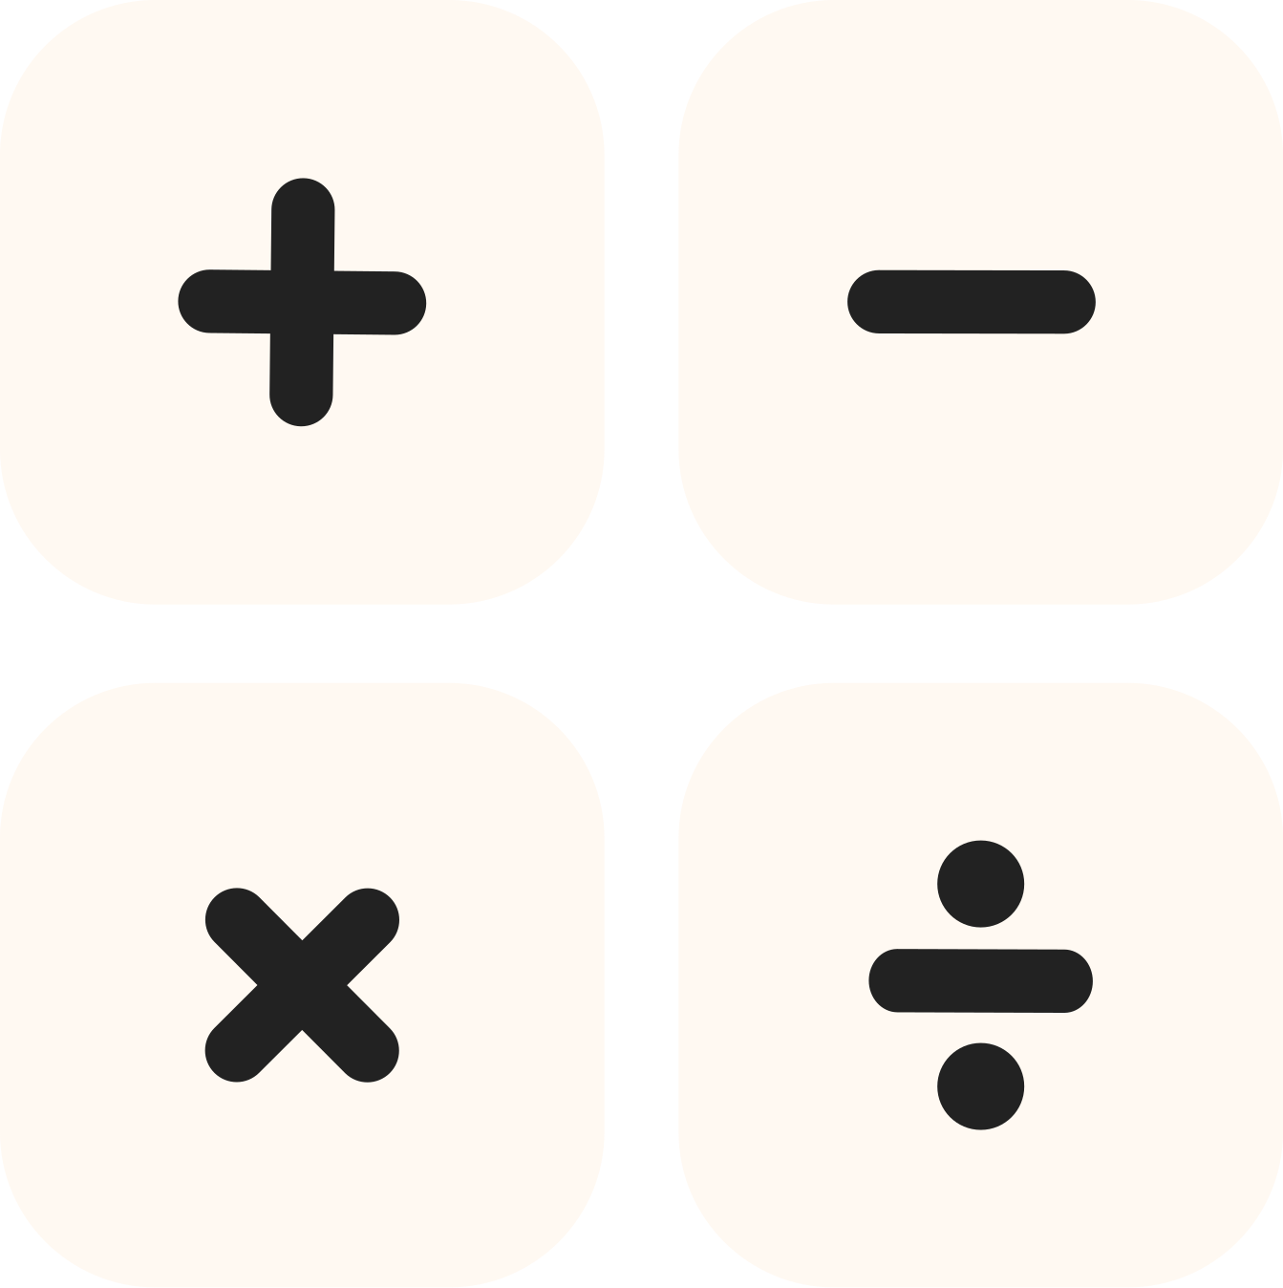
Future Improvements
1
2
3
Scientific Calculator Features: Addition of advanced functions (trigonometric, logarithmic, etc.).
History of Calculations: Implementing a history feature to track previous calculations
Improved Styling: Enhancing the visual design for a more polished user interface.

Slide 8
PROJECT
SCREENSHOT

Slide 9
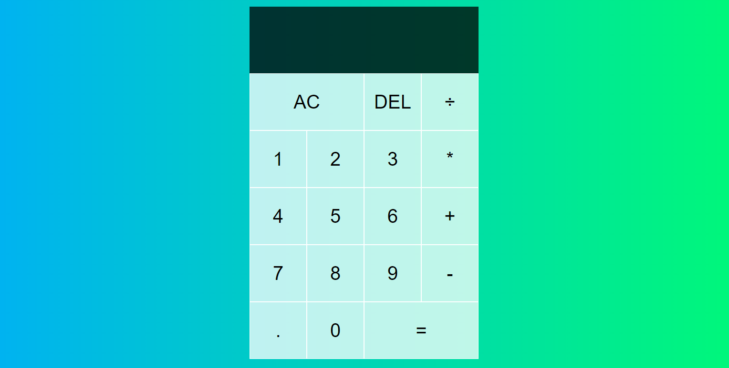

Slide 10
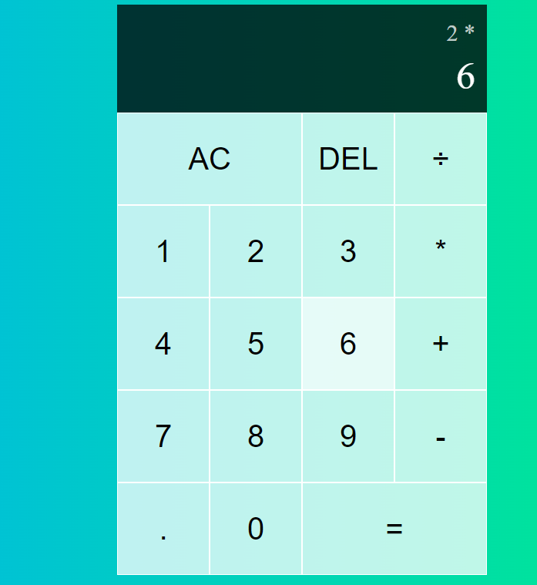
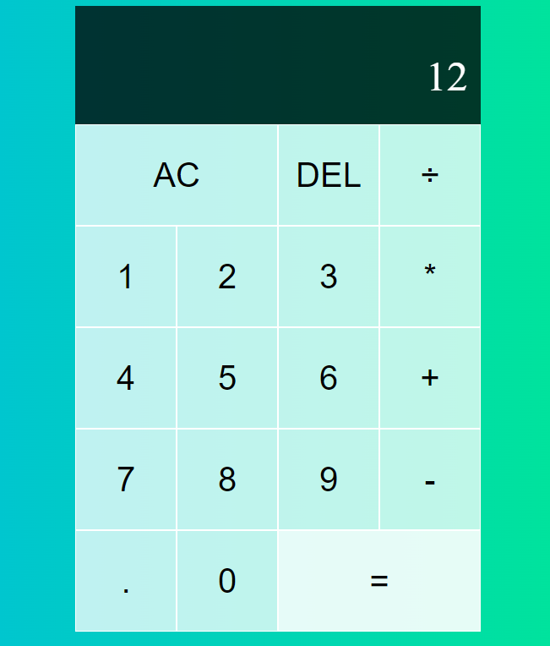

Slide 11

THANK YOU
Contact us if you are interested in our project.

